Slide 1
STAT 717: Lecture 2
Characterizing and Displaying Multivariate Data
Vitaly Druker
September 02, 2021

Slide 2
Univariate Statistics

Slide 3
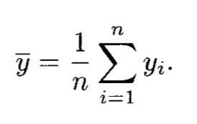


Sample Mean
Transformation

Slide 4
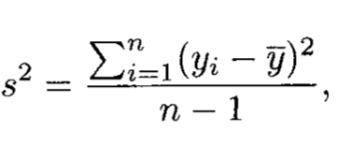

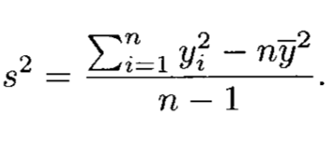
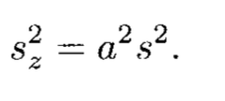
Sample Variance
Transformation

Slide 5
Bivariate Random Variables

Slide 6
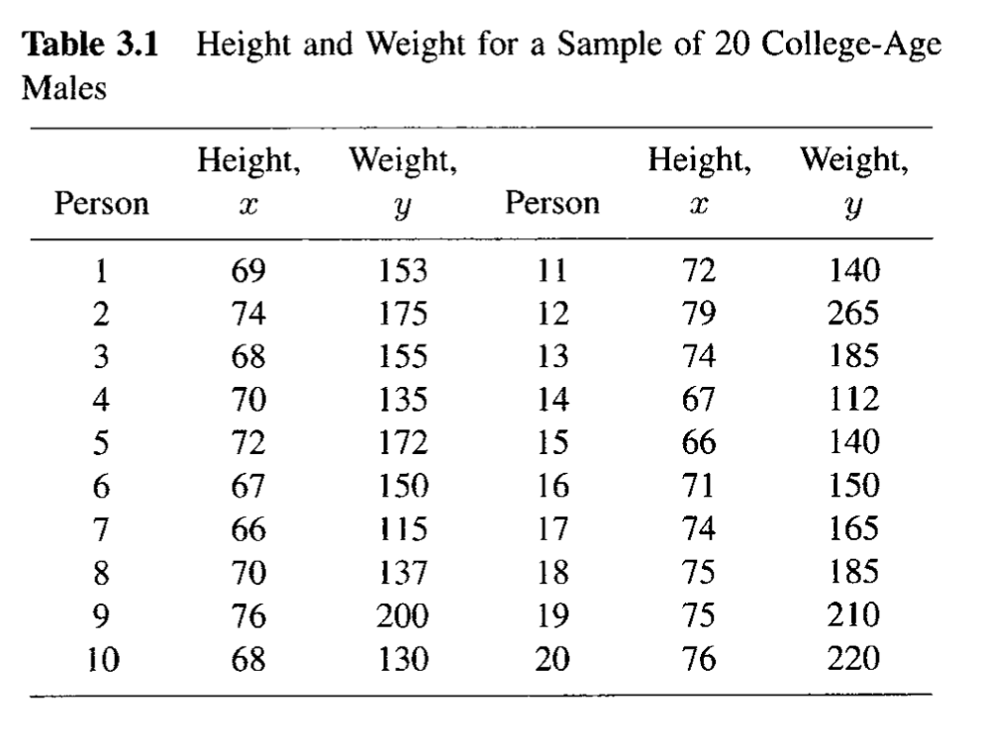
Data

Slide 7
Covariance
Generally, if there are two variables measured on the same unit then they tend to covary.
What happens if y tends to be above the mean when x is above the mean?
$$cov\left(x, y\right)= σ_{\left\{xy\right\}}=E[\left(x −μ_{x}\right)\left(y −μ_{y}\right)]$$

Slide 8
Covariance Implications
If covariance is 0 are the two variables independent?

Slide 9
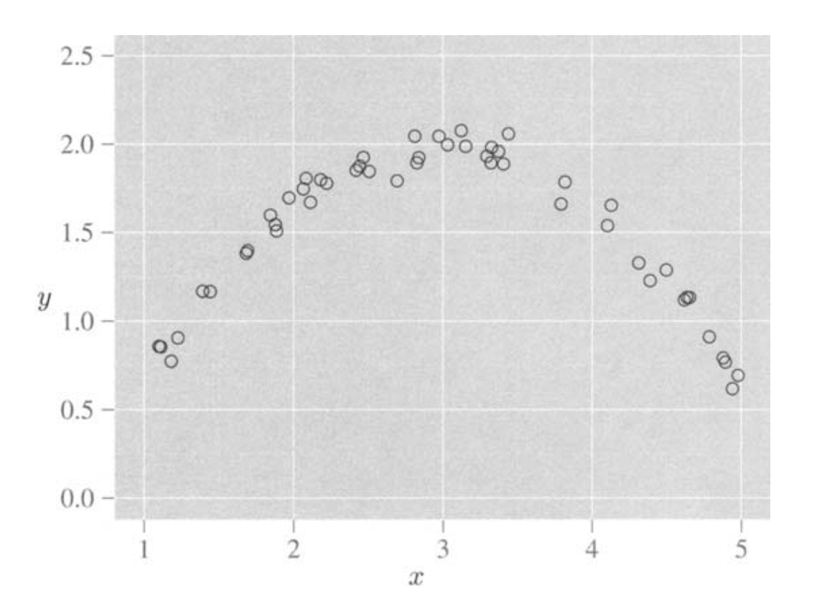

Slide 10
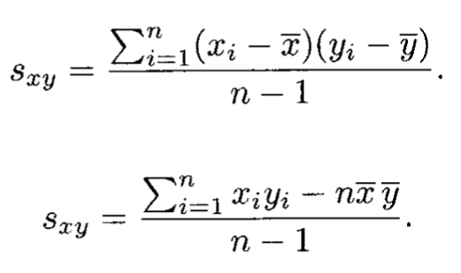
Sample Covariance

Slide 11
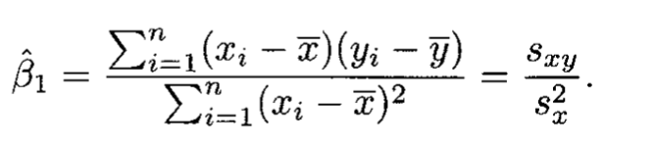
Slope of simple linear model

Slide 12
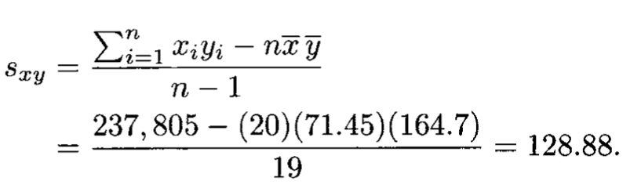
Covariance of Height/Weight

Slide 13
What are some problems with covariance?

Slide 14
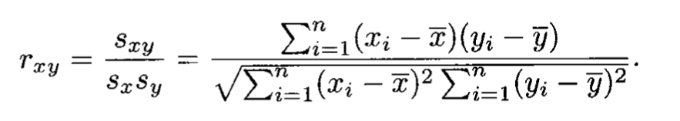
Correlation

Slide 15
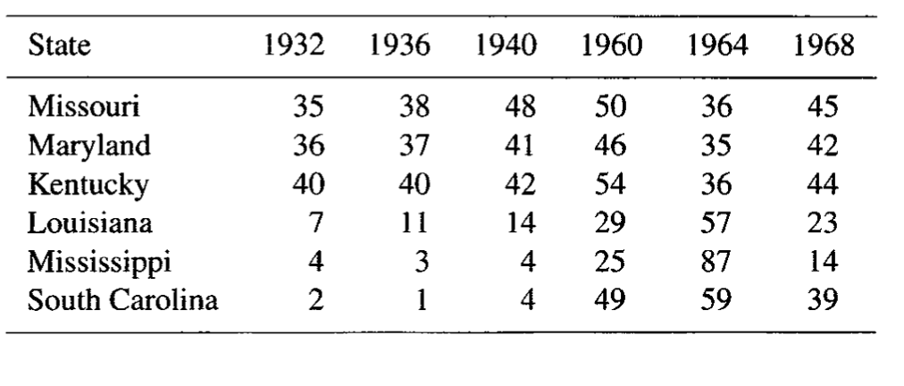
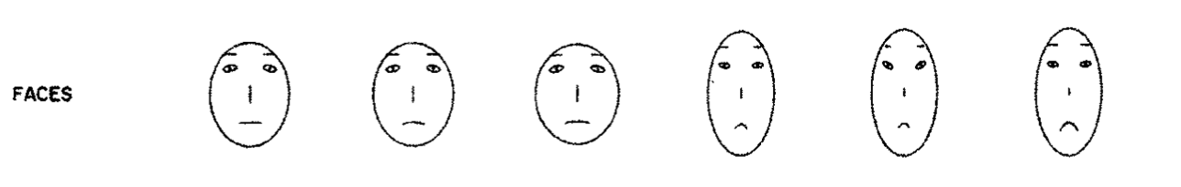
Visualization
More later – but this one in the book is wild to me

Slide 16
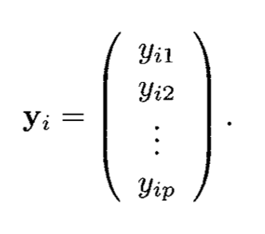
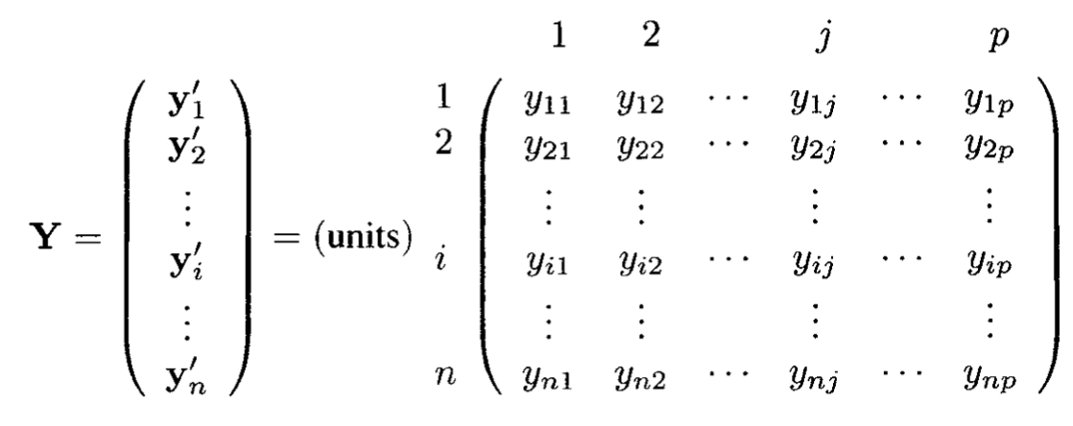
Mean Vectors
Each row contains all the observations for the jth measurement (for example weight)

Slide 17
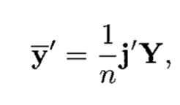
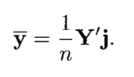
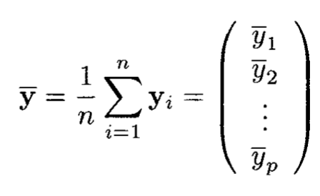
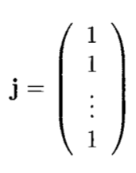
Mean Vectors

Slide 18
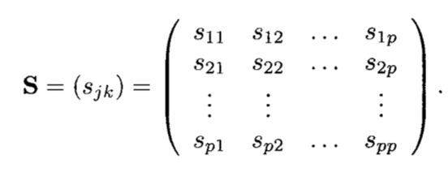
Covariance Matrix

Slide 19
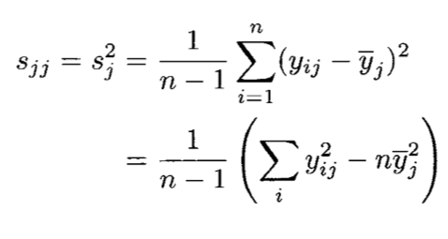
Covariance Matrix: Method 1

Slide 20
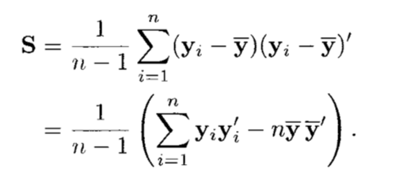
Covariance Matrix: Method 2

Slide 21
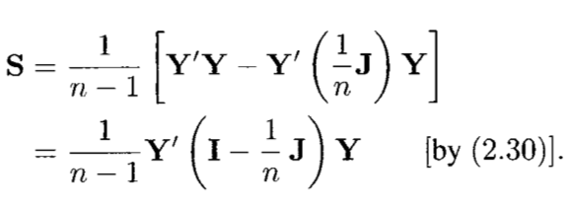
Covariance Matrix: Method 3

Slide 22
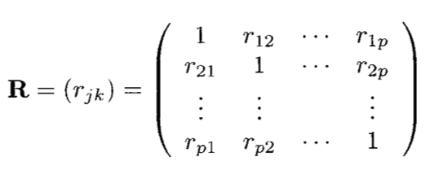
Correlation Matrix
Same idea as the covariance matrix

Slide 23
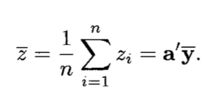
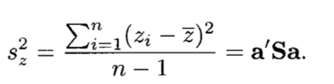
Linear Combinations of Variables
Multiply each y by a coefficients (like in linear regression). Remember a is column vector

Slide 24
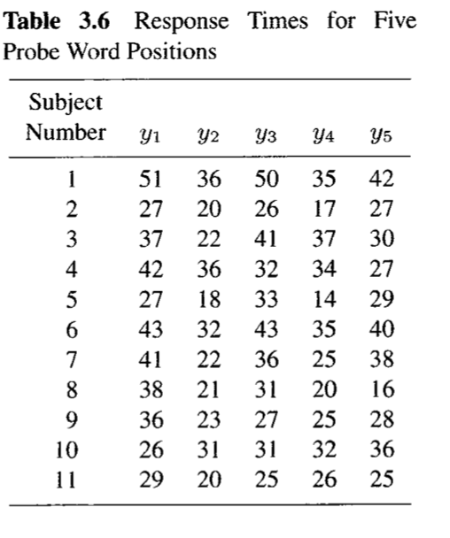
This can be expanded to lots of different linear combinations

Slide 25
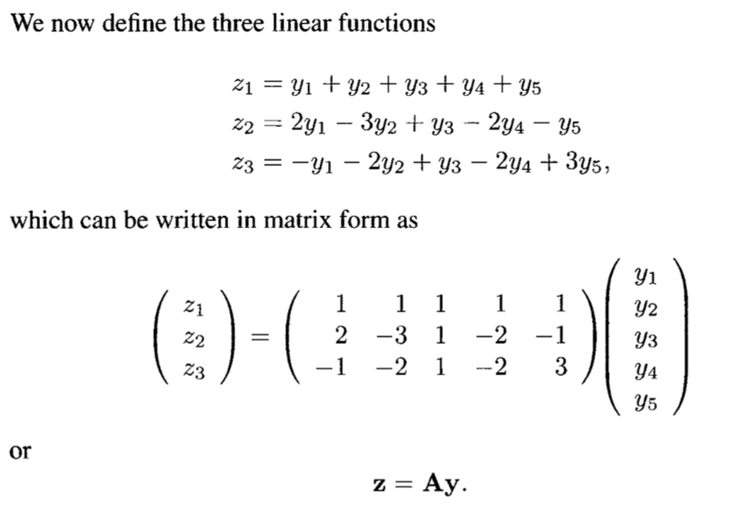
Linear Combinations

Slide 26
Homework

Slide 27

Measures of overall variability

Slide 28
Missing Values
You can fill in the holes by:
Column mean
Regression
This is a very involved topic - see the `mice` package in R
For example – why just linear regression?

Slide 29
Homework
Read chapter 3 of MMA
Read chapter 2 of Applied Multivariate Analysis

